Slide 1
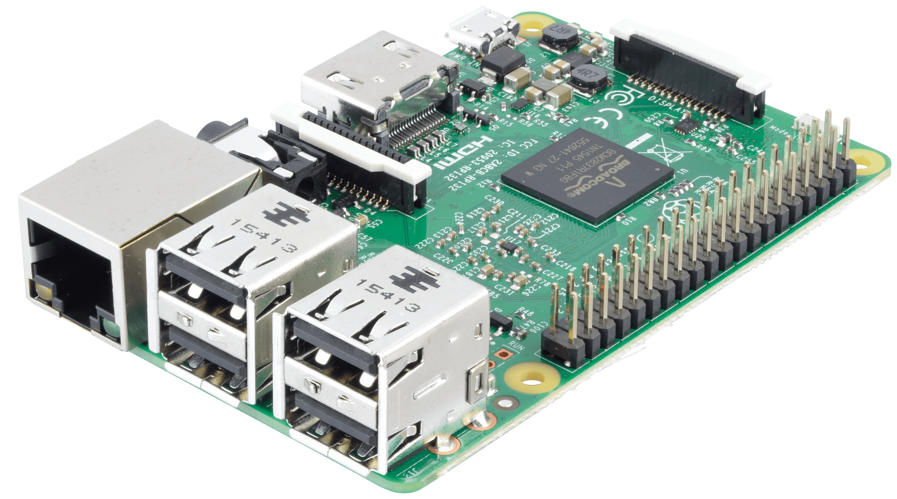

Summer Camp 2022
Nicholas Hinojosa
South Texas College

Slide 2




NICHOLAS HINOJOSA
South Texas College Computer Science Instructor (7+ years)
Associates of Mathematics
Bachelors in CIT
Masters in IT from UTPA
Certifications from Cisco (CCNA, CCENT)
Certification from SANS (GSEC)
Certification from CompTIA (Security+)
Certification from AWS
Certification from EC-Council (Certified Ethical Hacker)
Certificate from Google (Google IT Support Pro)
Programming I, II, III, C Programming
Survey of Programming, Advanced Web Design
Advanced Networking, Database Management
Internet/Internet Server Integration
Fundamentals of Information Security
Digital Forensics
Advanced Network Security

Slide 3
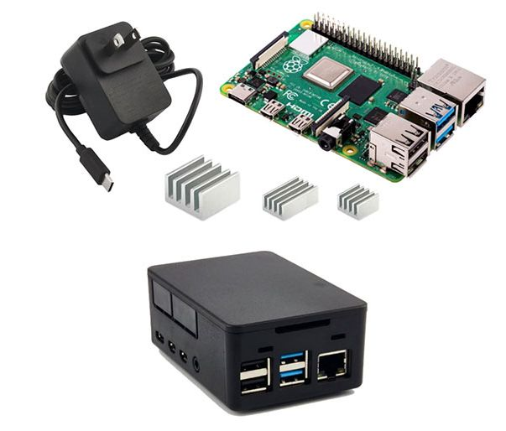
Raspberry Pi 4B Kit-4GB
The latest model of Raspberry Pi 4B with 4GB of RAM
Case for Raspberry Pi 4
A UL Approved Power Supply, 5.1V 3.0A, Black, USB-C connector
Aluminum Heatsinks, 3 pieces
An operating system image on a microSD card
A Micro HDMI to HDMI Cable

Slide 4
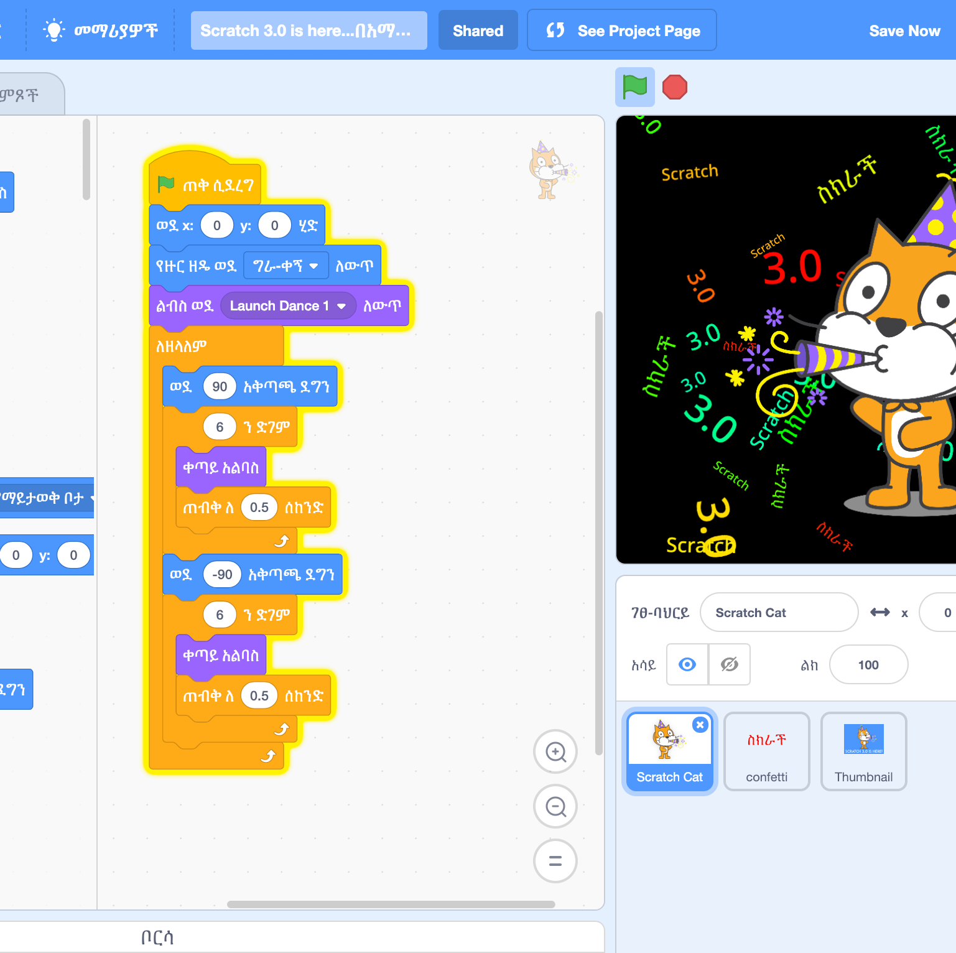
Tentative Schedule
Day 1 – Assemble Raspberry PI and install Scratch3
Day 2 – Learn the basic of Computer Programming
Day 3 – Game Development
Day 4 – Advanced Game Development
Day 5 – Story Development

Slide 5
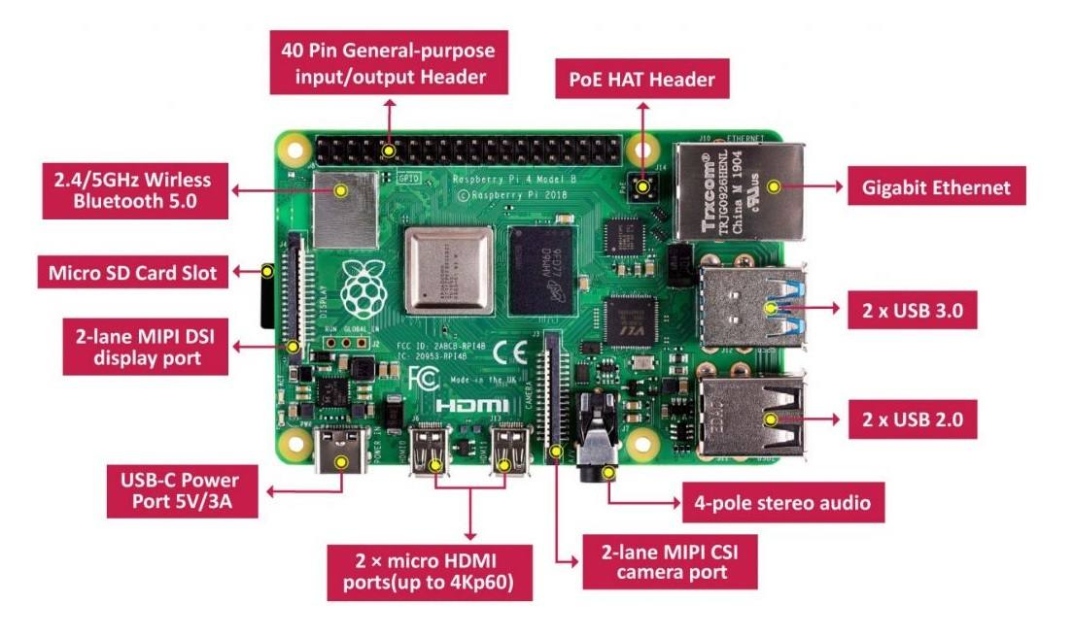

Slide 6

GITHUB WEBSITE
https://github.com/nhinojosa/raspberry-pi

Slide 7

Setup PI
Place PI in Case
Connect HDMI, Power, Mouse, Keyboard, and Ethernet Cables
Power on
Install Scratch3
Start Coding
apt update
apt install Scratch3

